Slide 1
Graph Algorithm
Graph Traversal

Slide 2
Graph Traversals
Graph traversal means visiting every vertex and edge exactly once in a well-defined order.
Ensure that each vertex of the graph is visited exactly once.
During a traversal, it is important that you track which vertices have been visited.
TRAVERSAL ALGORITHMS
Breadth First Search
Depth First Search
Both Traversal BFS and DFS provide a traversal tree:
When a node x is visited, it is labeled as visited, and it is added to the tree.
If the traversal got to the node x from node y, y is viewed as the parent of x, and x a child of y.

Slide 3
Depth First Search
The DFS algorithm is a recursive algorithm that uses the idea of backtracking. It involves exhaustive searches of all the nodes by going ahead, if possible.
Backtrack means that when you are moving forward and there are no more nodes along the current path, you move backwards on the same path to find nodes to traverse.
DFS uses a stack to remember to get the next vertex to start a search, when a dead end occurs in any iteration.

Slide 4
Depth First Search
Rule 1 − Visit the adjacent unvisited vertex. Mark it as visited. Display it. Push it in a stack.
Rule 2 − If no adjacent vertex is found, pop up a vertex from the stack (It will pop up all the vertices from the stack, which do not have adjacent vertices).
Rule 3 − Repeat Rule 1 and Rule 2 until the stack is empty.

Slide 5
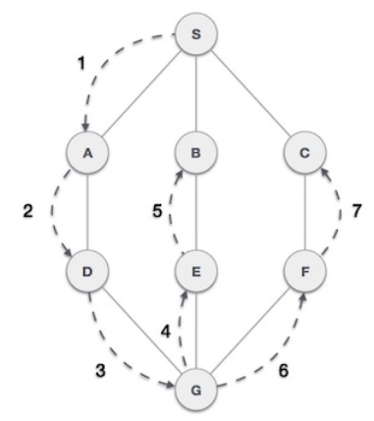
Depth First Search
Depth First Search (DFS) algorithm traverses a graph in a depthwise motion.
Uses a stack to remember to get the next vertex to start a search.
When no more vertex is found to travers a dead end occurs in any iteration, pop the node from stack.
S
S | A
S | A | D
S | A | D | G
S | A | D | G | E
S | A | D | G | E | B
S | A | D | G | E | B
S | A | D | G | E | B
S | A | D | G | E | B | F | C
S | A | D | G | E | B | F | C

Slide 6
Visited Array
F
C
A
B
C
D
E
F
G
H
A
B
D
H
G
E
Task: Conduct a depth-first search of the graph starting with node D

Slide 7
Visited Array
F
C
A
B
C
D | √
E
F
G
H
D
A
B
D
H
G
E
The order nodes are visited:
D
Visit D

Slide 8
Visited Array
F
C
A
B
C
D | √
E
F
G
H
D
A
B
D
H
G
E
The order nodes are visited:
D
Consider nodes adjacent to D, decide to visit C first (Rule: visit adjacent nodes in alphabetical order)

Slide 9
Visited Array
F
C
A
B
C | √
D | √
E
F
G
H
C
D
A
B
D
H
G
E
The order nodes are visited:
D, C
Visit C

Slide 10
Visited Array
F
C
A
B
C | √
D | √
E
F
G
H
C
D
A
B
D
H
G
E
The order nodes are visited:
D, C
No nodes adjacent to C; cannot continue ➔ backtrack, i.e., pop stack and restore previous state

Slide 11
Visited Array
F
C
A
B
C | √
D | √
E
F
G
H
D
A
B
D
H
G
E
The order nodes are visited:
D, C
Back to D – C has been visited, decide to visit E next

Slide 12
Visited Array
F
C
A
B
C | √
D | √
E | √
F
G
H
E
D
A
B
D
H
G
E
The order nodes are visited:
D, C, E
Back to D – C has been visited, decide to visit E next

Slide 13
Visited Array
F
C
A
B
C | √
D | √
E | √
F
G
H
E
D
A
B
D
H
G
E
The order nodes are visited:
D, C, E
Only G is adjacent to E

Slide 14
Visited Array
F
C
A
B
C | √
D | √
E | √
F
G | √
H
G
E
D
A
B
D
H
G
E
The order nodes are visited:
D, C, E, G
Visit G

Slide 15
Visited Array
F
C
A
B
C | √
D | √
E | √
F
G | √
H
G
E
D
A
B
D
H
G
E
The order nodes are visited:
D, C, E, G
Nodes D and H are adjacent to G. D has already been visited. Decide to visit H.

Slide 16
Visited Array
F
C
A
B
C | √
D | √
E | √
F
G | √
H | √
H
G
E
D
A
B
D
H
G
E
The order nodes are visited:
D, C, E, G, H
Visit H

Slide 17
Visited Array
F
C
A
B
C | √
D | √
E | √
F
G | √
H | √
H
G
E
D
A
B
D
H
G
E
The order nodes are visited:
D, C, E, G, H
Nodes A and B are adjacent to F. Decide to visit A next.

Slide 18
Visited Array
F
C
A | √
B
C | √
D | √
E | √
F
G | √
H | √
A
H
G
E
D
A
B
D
H
G
E
The order nodes are visited:
D, C, E, G, H, A
Visit A

Slide 19
Visited Array
F
C
A | √
B
C | √
D | √
E | √
F
G | √
H | √
A
H
G
E
D
A
B
D
H
G
E
The order nodes are visited:
D, C, E, G, H, A
Only Node B is adjacent to A. Decide to visit B next.

Slide 20
Visited Array
F
C
A | √
B | √
C | √
D | √
E | √
F
G | √
H | √
B
A
H
G
E
D
A
B
D
H
G
E
The order nodes are visited:
D, C, E, G, H, A, B
Visit B

Slide 21
Visited Array
F
C
A | √
B | √
C | √
D | √
E | √
F
G | √
H | √
A
H
G
E
D
A
B
D
H
G
E
The order nodes are visited:
D, C, E, G, H, A, B
No unvisited nodes adjacent to B. Backtrack (pop the stack).

Slide 22
Visited Array
F
C
A | √
B | √
C | √
D | √
E | √
F
G | √
H | √
H
G
E
D
A
B
D
H
G
E
The order nodes are visited:
D, C, E, G, H, A, B
No unvisited nodes adjacent to A. Backtrack (pop the stack).

Slide 23
Visited Array
F
C
A | √
B | √
C | √
D | √
E | √
F
G | √
H | √
G
E
D
A
B
D
H
G
E
The order nodes are visited:
D, C, E, G, H, A, B
No unvisited nodes adjacent to H. Backtrack (pop the stack).

Slide 24
Visited Array
F
C
A | √
B | √
C | √
D | √
E | √
F
G | √
H | √
E
D
A
B
D
H
G
E
The order nodes are visited:
D, C, E, G, H, A, B
No unvisited nodes adjacent to G. Backtrack (pop the stack).

Slide 25
Visited Array
F
C
A | √
B | √
C | √
D | √
E | √
F
G | √
H | √
D
A
B
D
H
G
E
The order nodes are visited:
D, C, E, G, H, A, B
No unvisited nodes adjacent to E. Backtrack (pop the stack).

Slide 26
Visited Array
F
C
A | √
B | √
C | √
D | √
E | √
F
G | √
H | √
D
A
B
D
H
G
E
The order nodes are visited:
D, C, E, G, H, A, B
F is unvisited and is adjacent to D. Decide to visit F next.

Slide 27
Visited Array
F
C
A | √
B | √
C | √
D | √
E | √
F | √
G | √
H | √
F
D
A
B
D
H
G
E
The order nodes are visited:
D, C, E, G, H, A, B, F
Visit F

Slide 28
Visited Array
F
C
A | √
B | √
C | √
D | √
E | √
F | √
G | √
H | √
D
A
B
D
H
G
E
The order nodes are visited:
D, C, E, G, H, A, B, F
No unvisited nodes adjacent to F. Backtrack.

Slide 29
Visited Array
F
C
A | √
B | √
C | √
D | √
E | √
F | √
G | √
H | √
A
B
D
H
G
E
The order nodes are visited:
D, C, E, G, H, A, B, F
No unvisited nodes adjacent to D. Backtrack.

Slide 30
Visited Array
F
C
A | √
B | √
C | √
D | √
E | √
F | √
G | √
H | √
A
B
D
H
G
E
The order nodes are visited:
D, C, E, G, H, A, B, F
Stack is empty. Depth-first traversal is done.

Slide 31
Depth First Search - Iterative
DFS-iterative (G, r): //Where G is graph and s is source vertex
let S be stack
S.push( r ) //Inserting s in stack
mark r as visited.
while (S is not empty):
v = S.top() //Pop a vertex from stack to visit next
S.pop()
//Push all the neighbours of v in stack that are not visited
for all neighbours w of v in Graph G:
if w is not visited :
S.push( w )
mark w as visited

Slide 32
Depth First Search - Recursive
DFS-recursive(G, s):
mark s as visited
for all neighbours w of s in Graph G:
if w is not visited:
DFS-recursive(G, w)
Pick a starting node and push all its adjacent nodes into a stack.
Pop a node from stack to select the next node to visit and push all its adjacent nodes into a stack.
Repeat this process until the stack is empty.
Ensure that the nodes that are visited are marked. This will prevent you from visiting the same node more than once.

Slide 33
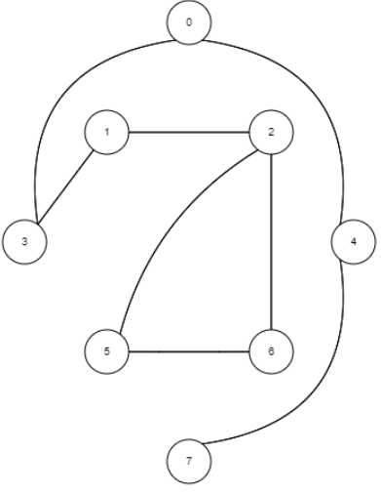
Depth First Search Practice

Slide 34
Application of Depth First Search
Finding connected components.
Finding the bridges of a graph
Solving puzzles with only one solution, such as mazes
Topological Sorting

Slide 35
BFS – DFS Comparison
Breadth First Search
Depth First Search

